Slide 1

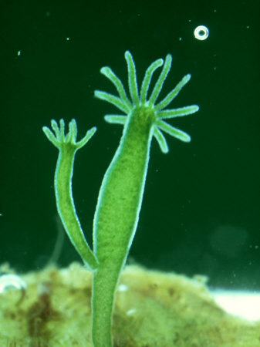
Pune District Education Association’s
Prof. Ramakrishna More Arts, Commerce And Science College, Akurdi
DBT-STAR COLLEGE SCHEME
Guest Lecture
OrganiZed By
Department Of Zoology
W e l c o m e
Dr. Surendra Ghaskadbi
CSIR- Emeritus Scientist
Agarkar Research Institute, Pune
Date- 23/08/2019
Dr. Morey R.A. Dr. Shaikh A.A. Dr. Khandagle A.J. Dr. M.G. Chaskar
Overall Coordinator HOD Zoology Vice- Principal Principal
DBT-Star College Scheme

